Slide 1

Progress of Reviewing Fast-Detrapping Retention
20240430
진명
1/16
School of Electrical Engineering, Seoul National University

Slide 2

Content
Correction
TCAD & Model Structure
Model Comparison
Calibration Method with Constructed TCAD
Direct tunneling
Trap to band tunneling
Discussion about Barrier Lowering
Proposal for the Poole-Frenkel emission under thin layer
Evidences found in TCAD
2/16
School of Electrical Engineering, Seoul National University

Slide 3

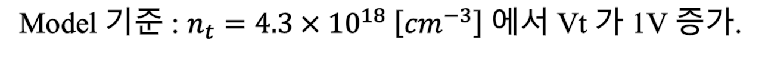
Correction
Nctn dependency => Vt = 1V 수준의 nctn
(Page 3 우측단 중반 중에서 [1])
Model 기준 : $n_{t}=4.3×{10}^{18} \left[cm^{−3}\right]$ 에서 Vt 가 1V 증가.
[1] Kim, Minsoo, and Hyungcheol Shin. IEEE Transactions on Electron Devices 68.7 (2021): 3339-3345.
3/16
School of Electrical Engineering, Seoul National University

Slide 4
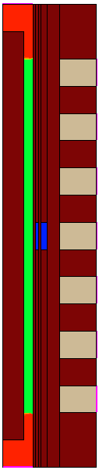
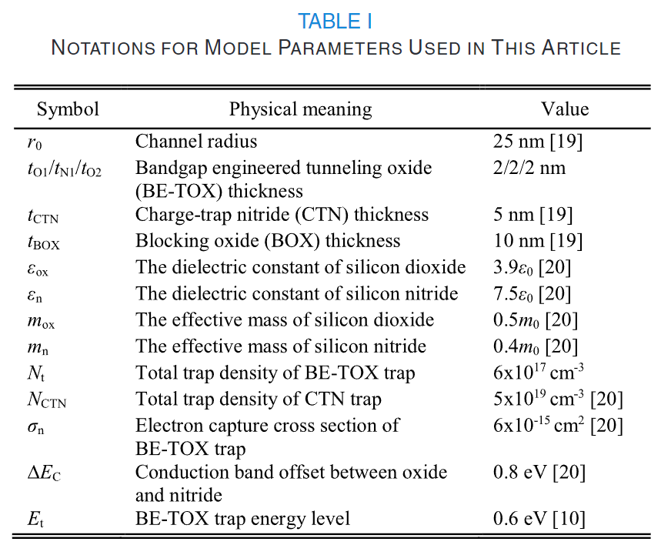
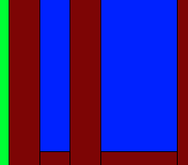
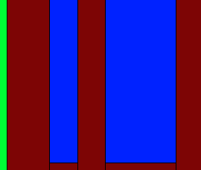


TCAD & Model Structure for the review
Filler oxide = 17nm, Silicon = 8nm
Oxide envelope
(prevent LM)
$t_{tox1}=2 [nm]$
$t_{tox1}=3 [nm]$
CTN : fixedCharge code
Trap { (Fixedcharge conc=-4.3e18) }
[1] Kim, Minsoo, and Hyungcheol Shin. IEEE Transactions on Electron Devices 68.7 (2021): 3339-3345.
4/16
School of Electrical Engineering, Seoul National University

Slide 5
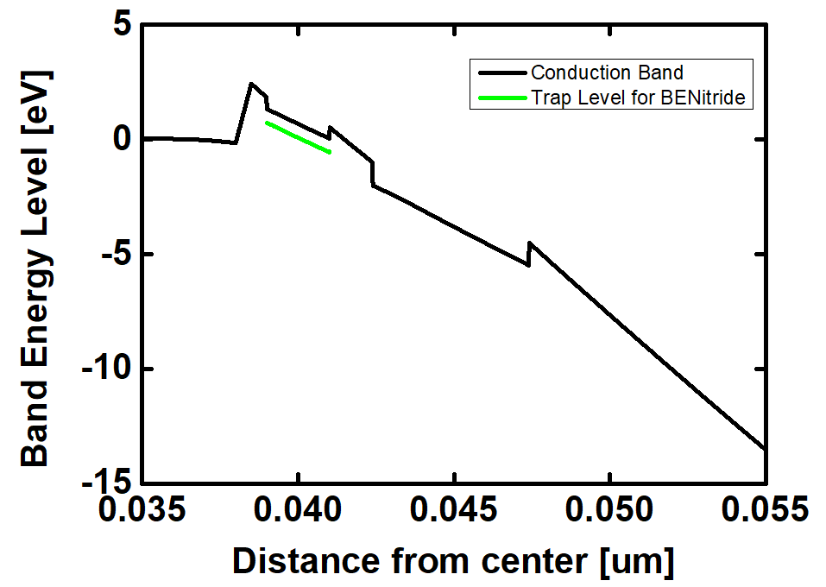
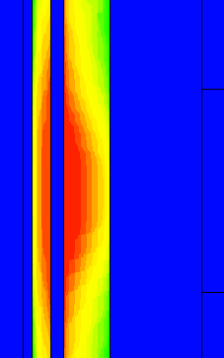
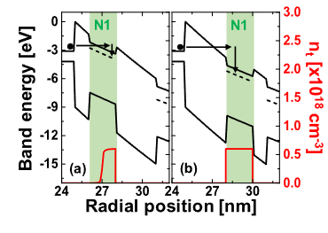
TCAD & Model Structure for the review
At $t_{tox1}=1 nm$, BENitride cannot be fully charged by program operation
CTN Trap
Not Trapped
Trapped
=> figure 4(a) [1]
[1] Kim, Minsoo, and Hyungcheol Shin. IEEE Transactions on Electron Devices 68.7 (2021): 3339-3345.
5/16
School of Electrical Engineering, Seoul National University

Slide 6
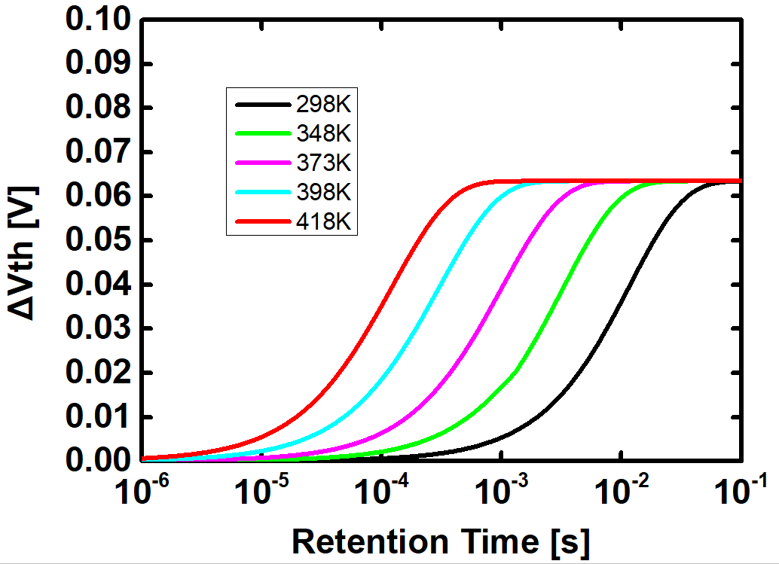
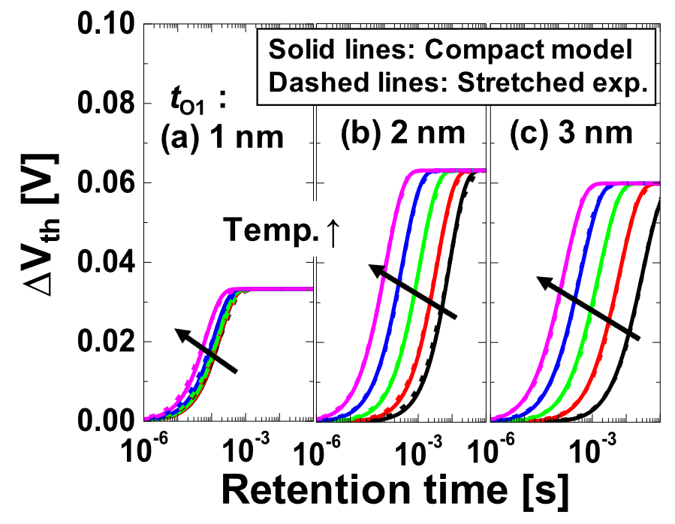
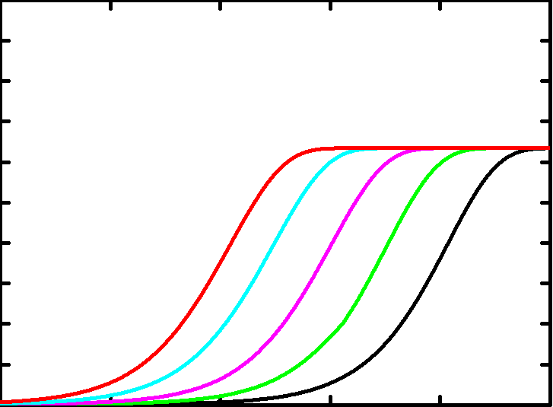
Model Comparison for the Review
Final Model Comparison
Temperature variation, 특정된 온도는 없음
>> 온도는 임의로 상정하여 경향성만 확인
Matched!
[1] Kim, Minsoo, and Hyungcheol Shin. IEEE Transactions on Electron Devices 68.7 (2021): 3339-3345.
6/16
School of Electrical Engineering, Seoul National University

Slide 7
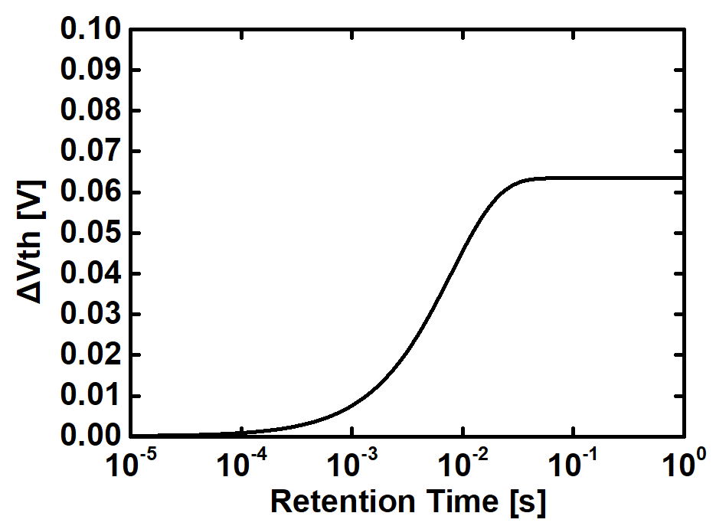
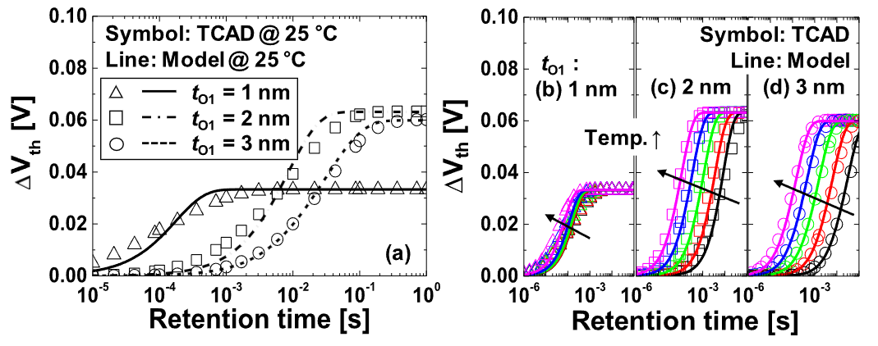
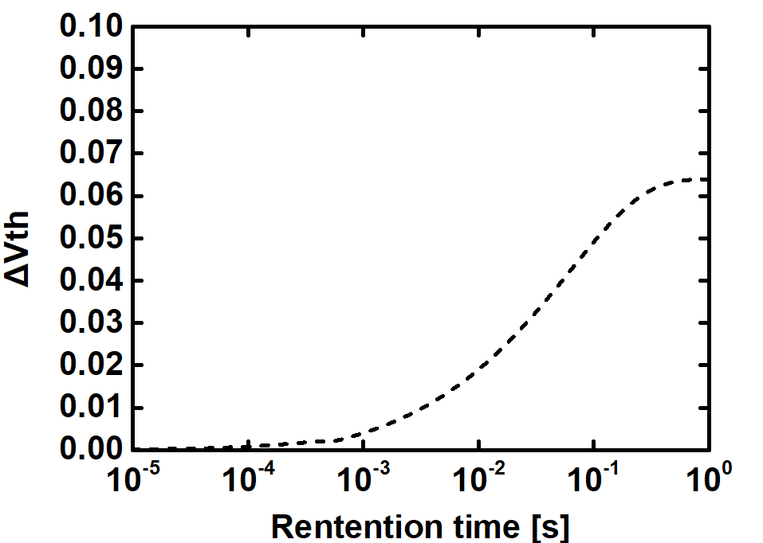
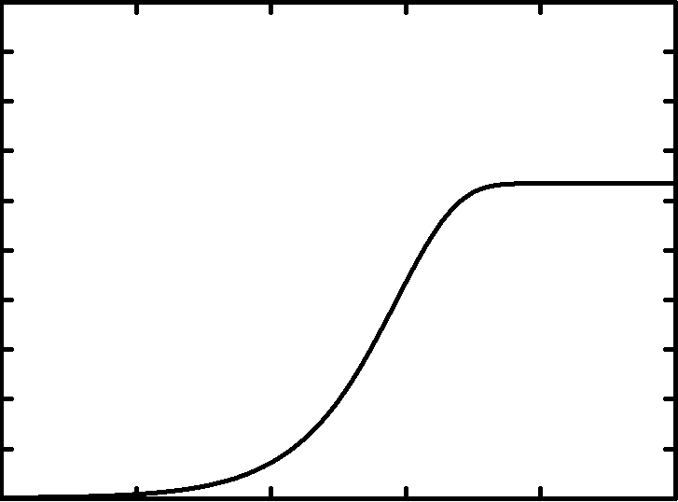


Model Comparison for the Review
TBT, DT, TE model matching
$t_{o1}=2nm$
$t_{o1}=3nm$
(figure 6(a) [1] matched)
다음장부터는, DT/PF , TBT 순서로 관련 parameter 들을 이번에 설계한 oxide enveloped 구조를 통해서 calibration할 것이다.
[1] Kim, Minsoo, and Hyungcheol Shin. IEEE Transactions on Electron Devices 68.7 (2021): 3339-3345.
7/16
School of Electrical Engineering, Seoul National University

Slide 8
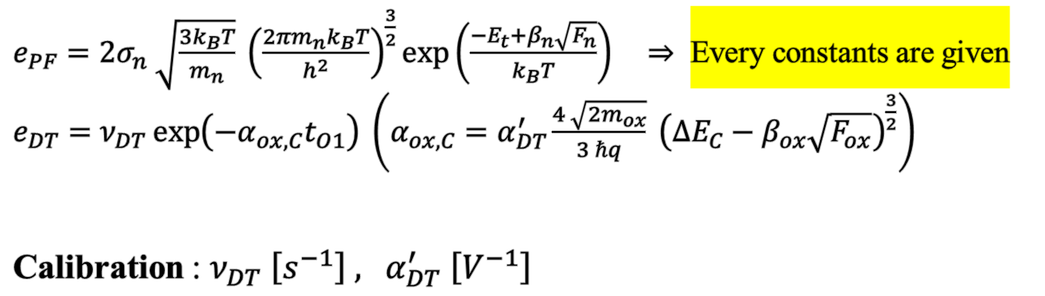
Direct Tunneling Calibration Method
Main Concept in TCAD Simulation
- eBarrierTunneling off
- GateCurrent(DirectTunneling) on
- PooleFenkel on
$e_{PF}=2σ_{n} \sqrt{\frac{3k_{B}T}{m_{n}}} {\left(\frac{2πm_{n}k_{B}T}{h^{2}}\right)}^{\frac{3}{2}}\exp\left(\frac{−E_{t}+β_{n}\sqrt{F_{n}}}{k_{B}T}\right) ⇒$ Every constants are given
$e_{DT}=ν_{DT}\exp\left(−α_{ox,C}t_{O1}\right) \left(α_{ox,C}=α_{DT}^{′}\frac{4 \sqrt{2m_{ox}}}{3 ℏq} {\left(ΔE_{C}−β_{ox}\sqrt{F_{ox}}\right)}^{\frac{3}{2}}\right)$
Calibration : $ν_{DT} \left[s^{−1}\right] , α_{DT}^{′} \left[V^{−1}\right]$
8/16
School of Electrical Engineering, Seoul National University

Slide 9
Direct Tunneling Calibration Method
$ν_{DT} =550 \left[s^{−1}\right] , α_{DT}^{′}=0.45 \left[V^{−1}\right]$
Symbol = TCAD (PF, DT on) / line = model
298K
318K
338K
358K
378K
398K
9/16
School of Electrical Engineering, Seoul National University

Slide 10
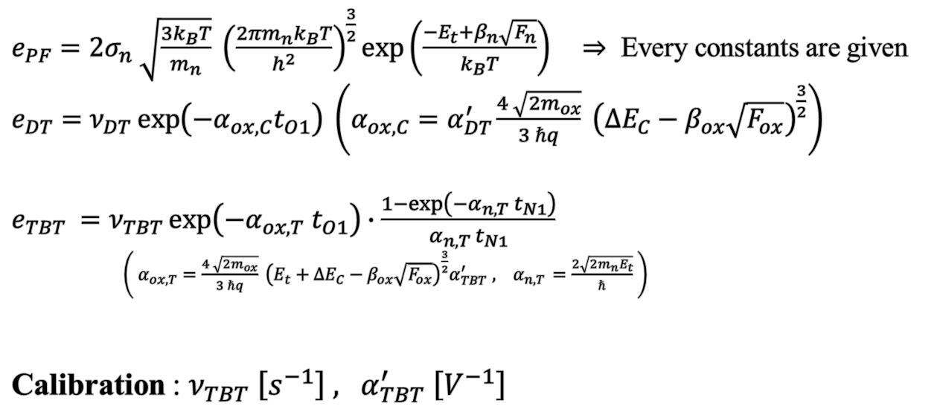
Trap to Band Tunneling Calibration
Main Concept in TCAD Simulation
- eBarrierTunneling on
- PooleFenkel on
$e_{PF}=2σ_{n} \sqrt{\frac{3k_{B}T}{m_{n}}} {\left(\frac{2πm_{n}k_{B}T}{h^{2}}\right)}^{\frac{3}{2}}\exp\left(\frac{−E_{t}+β_{n}\sqrt{F_{n}}}{k_{B}T}\right) ⇒$ Every constants are given
$e_{DT}=ν_{DT}\exp\left(−α_{ox,C}t_{O1}\right) \left(α_{ox,C}=α_{DT}^{′}\frac{4 \sqrt{2m_{ox}}}{3 ℏq} {\left(ΔE_{C}−β_{ox}\sqrt{F_{ox}}\right)}^{\frac{3}{2}}\right)$
$e_{TBT} =ν_{TBT}\exp\left(−α_{ox,T} t_{O1}\right)∙\frac{1−\exp\left(−α_{n,T} t_{N1}\right)}{α_{n,T} t_{N1}}$
$\left( α_{ox,T}=\frac{4 \sqrt{2m_{ox}}}{3 ℏq} {\left(E_{t}+ΔE_{C}−β_{ox}\sqrt{F_{ox}}\right)}^{\frac{3}{2}}α_{TBT}^{′} , { α}_{n,T }=\frac{2\sqrt{2m_{n}E_{t}}}{ℏ} \right)$
Calibration : $ν_{TBT} \left[s^{−1}\right] , α_{TBT}^{′} \left[V^{−1}\right]$
Tunneling amount average
[1] Kim, Minsoo, and Hyungcheol Shin. IEEE Transactions on Electron Devices 68.7 (2021): 3339-3345.
10/16
School of Electrical Engineering, Seoul National University

Slide 11

Trap to Band Tunneling Calibration
$ν_{TBT} =2.5×{10}^{7} \left[s^{−1}\right] , α_{TBT}^{′}=1 \left[V^{−1}\right]$
High temperature error is due to TBT modeling assumption of making average + barrier lowering
Symbol = TCAD (TBT on) / line = model
2nm
298K
338K
378K
3nm
$β ↑ :$ temperature affecting TBT
298K
338K
378K
11/16
School of Electrical Engineering, Seoul National University

Slide 12
Discussion about the Result Difference
Band diagram difference over retention at TCAD / Model
Model:
Assumes conduction band in 0V at retention state
TCAD:
(-) Voltage is given at Silicon surface, inversion hole occurs at channel along retention
vs
Difference of metal used for gate contact => Tungsten / TiNitride …
Tunsgten
Work Function = 4.25eV
TiNitride
Work Function = 4.66eV
vs
=> At retention state, the difference of work function of gate metals may cause some electric field intensity difference
12/16
School of Electrical Engineering, Seoul National University

Slide 13
Discussion about Barrier Lowering
Barrier lowering at Direct Tunneling Mechanism
$e_{DT}=ν_{DT}\exp\left(−α_{ox,C}t_{O1}\right) \left(α_{ox,C}=α_{DT}^{′}\frac{4 \sqrt{2m_{ox}}}{3 ℏq} {\left(ΔE_{C}−β_{ox}\sqrt{F_{ox}}\right)}^{\frac{3}{2}}\right)$
If $ΔV_{t}$ gets large enough, $ΔE_{C}−β_{ox}\sqrt{F_{ox}}<0$ may occur, making emission or tunneling amount exceed capture amount.
Plus, thermal relation is observed in DT parameter calibration => this is due to Poole-Frenkel emission is dominant when TBT << DT + PF (PF < DT)
13/16
School of Electrical Engineering, Seoul National University

Slide 14


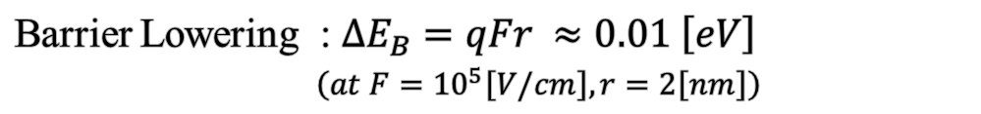
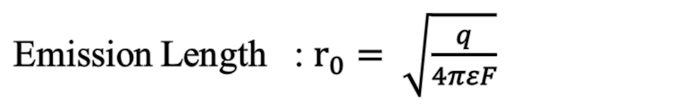

Discussion about Barrier Lowering
Poole-Frenkel Emission along thick layer
Barrier Lowering : $ΔE_{B}=−β\sqrt{F}$
Emission Length : $r_{0}= \sqrt{\frac{q}{4πεF}}$
~ 현재 scale으로는 $r_{0} ≈2.5\left[nm\right] >t_{n}$
Poole-Frenkel Emission along thin layer
$⇒F$ : external Field
Barrier Lowering : $ΔE_{B}=qFr ≈0.01 \left[eV\right]$
$\left(at F={10}^{5}\left[V/cm\right], r=2\left[nm\right]\right)$
$$r$$
$∴$ Barrier Lowering의 정도는 thin layer에서 얕아진다
14/16
School of Electrical Engineering, Seoul National University

Slide 15
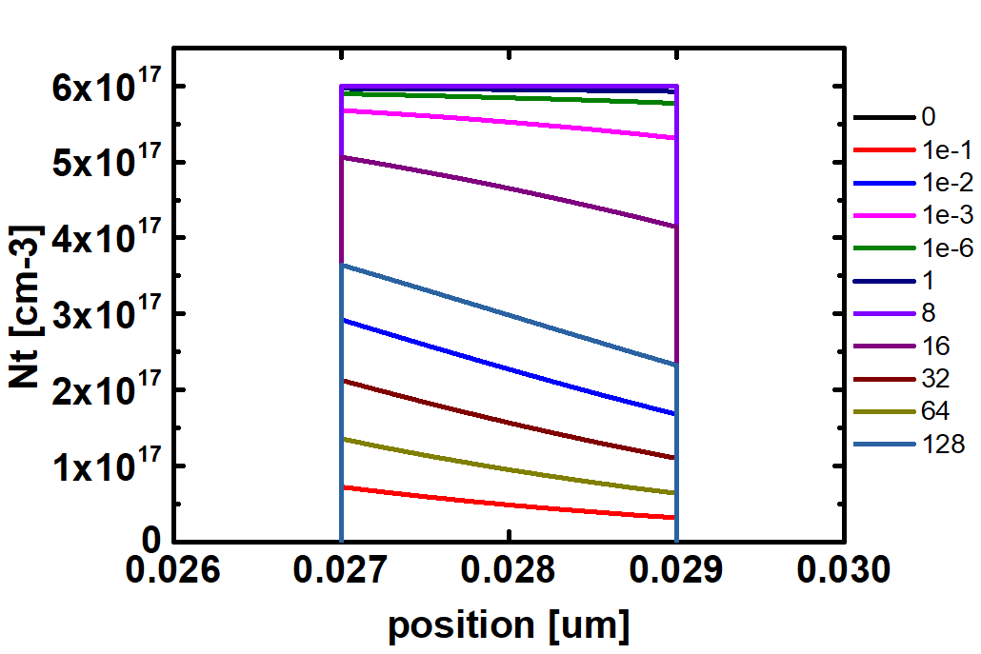
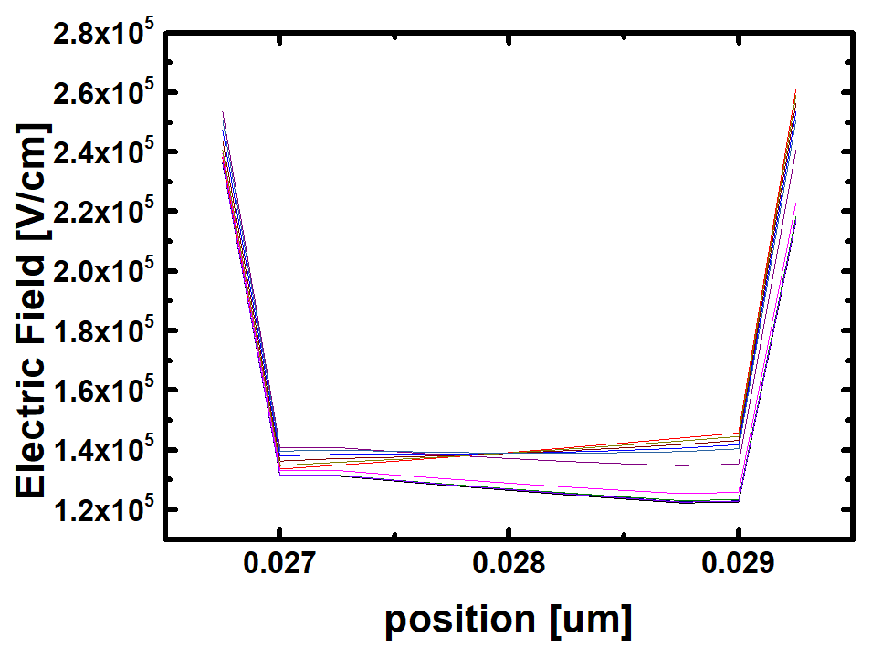

Discussion about Barrier Lowering
Evidence: Trap Charge Distribution along time
BENitride
While electric field along BENitride is almost consistent
time
$\sim 1.4×{10}^{5} [V/cm]$
To1-BENitride interface slower emission
BENitride-To2 interface faster emission
15/16
School of Electrical Engineering, Seoul National University

Slide 16
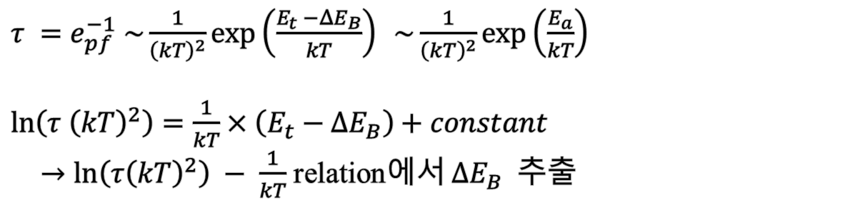
Future Works
Modify barrier lowering model for Poole-Frenkel emission
Extraction of proper barrier lowered amount along retention
$τ =e_{pf}^{−1} \sim \frac{1}{{\left(kT\right)}^{2}}exp\left(\frac{E_{t} −ΔE_{B}}{kT}\right) \sim \frac{1}{{\left(kT\right)}^{2}}exp\left(\frac{E_{a}}{kT}\right)$
$\ln\left(τ {\left(kT\right)}^{2}\right)=\frac{1}{kT}×\left(E_{t}−ΔE_{B}\right)+constant$
$→\ln\left(τ{\left(kT\right)}^{2}\right) − \frac{1}{kT}$ relation에서 $ΔE_{B}$ 추출
16/16
School of Electrical Engineering, Seoul National University

